Slide 1

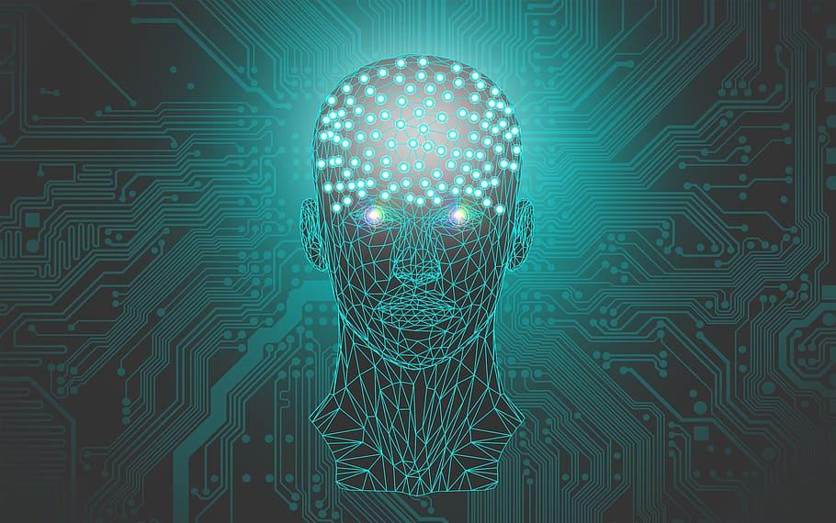
ARTIFICIAL INTELLIGENCE RECOMMENDATION SYSTEM FOR CANCER REHABILITATION SCHEME
DEPARTMENTT OF CSE
BATCH-12
S.NIVETHANARAYANI (2017PECCS183)
PALAGIRI VAISHNAVI (2017PECCS187)
RAMYAPRABA (2017PECCS203)
PROJECT GUIDE
MRS.P.VIJAYALAKSHMI

Slide 2
INTRODUCTION
Cancer is a group of diseases characterized by the uncontrollable growth and rapid spread of abnormal cells which damages the nearby healthy tissues of brain. If the spread is not controlled, it can result in death. And also, not all tumors are cancer but all cancers are tumor. Brain tumor was the most common cancer in worldwide, contributing 2,093,876 of the total number of new cases diagnosed in 2020. This can be made faster and more accurate. In this study we propose machine learning strategies to improve cancer characterization. Inspired by learning from CNN approaches. Only about 4 to 5 percent of all cancers are genetically inherited, or hereditary. It’s rare for a brain tumor to be genetically inherited. Symptoms of brain tumors depend on the location and size of the tumor. Some tumors cause direct damage by invading brain tissue and some tumors cause pressure on the surrounding brain. You’ll have noticeable symptoms when a growing tumor is putting pressure on your brain tissue.

Slide 3
LITERATURE SURVEY 1
Year of Publishing | Author name | Title of the Paper | Merits | Demerits
2020 | Prabhojot Kaur Chahal, Shreelekha Pandey & Shivani Goel | A Survey on brain tumor detection techniques for MR images | The survey presented here aims to help the researchers to derive the essential characteristics of brain tumor types and identifies various segmentation/classification techniques which are successful for detection of a range of brain diseases. | MR Images are reviewed with difficulties encountered in each to detect various brain tumor types
Link of the Page | https://link.springer.com/article/10.1007/s11042-020-08898-3

Slide 4
LITERATURE SURVEY 2
Year of Publishing | Author name | Title of the Paper | Merits | Demerits
2020 | R.Tamilselvi, A.Nagaraj, M.Parisa Beham, M.Bharkavi Sandhiya | BRAMSIT: A Database Brain tumor diagnosis and detection | The proposed MRI database, named as MRISIT, represents an initial attempt to provide a set of MRI scan images consisting of normal, abnormal along with its ground truth images of different axial position | Wrong detection of tumor could be explored by small experiments,for example each method have some kind of threshold value if the right threshold is not selected then probably the detection result would be wrong.
Link of the Page | https://ieeexplore.ieee.org/document/9167530/authors#authors

Slide 5
LITERATURE SURVEY 3
Year of Publishing | Author name | Title of the Paper | Merits | Demerits
2019 | T.M.Shahriar sazzad, K.M.Tanzibul Ahmmed,Misbah UI Hoque,Mahmuda Rahman | Development of automated brain tumor detection using MRI Images | The modalities of brain images are stated with illustrations and properly reviewed. | There is a large gap between radiologist and automated brain tumor detection persons due to the incomplete process flow between them.
Link of the Page | https://ieeexplore.ieee.org/document/8679240

Slide 6
LITERATURE SURVEY 4
Year of Publishing | Author name | Title of the Paper | Merits | Demerits
2019 | Mircea Gurbina, Mihaela Lascu, Dan Lascu | Tumor detection and classification of brain MRI image using different wavelet transforms and support vector machines | This paper put forward an analytical course of action for the recognition of brain tumors (BT). | Difficult to isolate heterogeneous cancer cells Possibility to isolate normal stem cells
Link of the Page | https://ieeexplore.ieee.org/document/8769040

Slide 7
LITERATURE SURVEY 5
Year of Publishing | Author name | Title of the Paper | Merits | Demerits
2018 | Annisa Wulandari, Riyanto Sigit, Mochamad Mobed Bachtiar | Brain tumor segmentation to calculate percentage tumor using MRI | This paper will discuss brain tumors which are segmented to calculate the area of the tumor and the percentage of area. | Not good for soft tissues (melanoma)
Link of the Page | https://ieeexplore.ieee.org/document/8628591

Slide 8
DEVELOPMENT
ENVIRONMENT
HARDWARE
HHSOFTWARE
Processor : Intel Pentium Dual Core 2.00GHz
Hard disk : 500 GB
RAM : 8 GB (minimum)
Python 3.6.4 version
Software Tool : Anaconda Navigator (IDE)

Slide 9
PROBLEM STATEMENT
Cancer is the most difficult problem in the field of medicine, and its postoperative recovery has become the most concerned problem for cancer patients.
In the field of medical image processing, brain tumor detection and segmentation using MRI Scan has become one of the most important and challenging research areas .
Magnetic resonance imaging (MRI) is a widely used imaging technique to assess these tumors, but the large amount of data produced by MRI needs manual segmentation in a reasonable time, limiting the use of precise quantitative measurements in the clinical practice. So, automatic and reliable segmentation methods are required.
Automatic segmentation is a challenging problem in which manual detection and segmentation of brain tumors using brain MRI scan forms a large part of human intervention for detection and segmentation taken per patient, is both tedious and has huge internal and external observer detection and segmentation variability. Hence there is high demand for an efficient and automatic brain tumor detection and segmentation using brain MR images to overcome errors in manual segmentation.
In Practice,the system uses HSI (Hyperspectral Imaging) to detect cancer cells.It is difficult to eliminate the ambiguities of matching spectral profiles with biological samples and therefore the presence of fundamental non-uniqueness is another limitation of HSI.
To overcome this difficulty, develop a system which detects the location of cancer cells through MR Images and also suggests some effective treatment like medications ,vaccines etc.. to physician

Slide 10
SYSTEM ARCHITECTURE

Slide 11
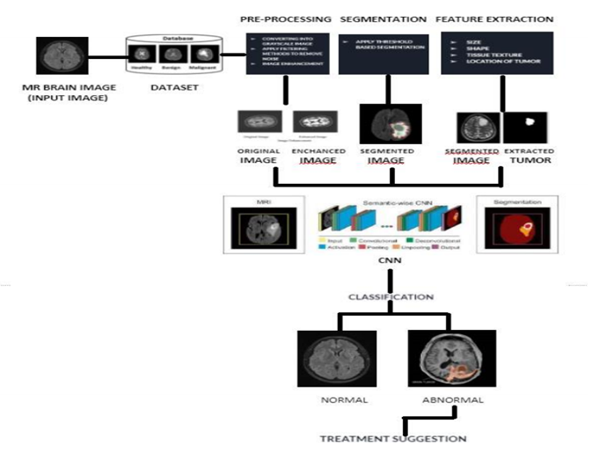

Slide 12
SYSTEM DESIGN
(UML DIAGRAMS)

Slide 13
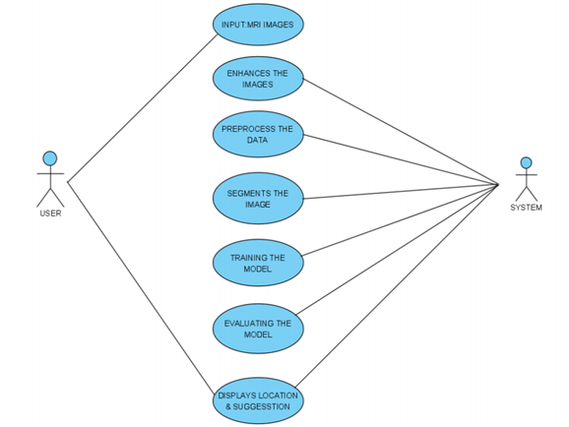
USECASE DIAGRAM

Slide 14
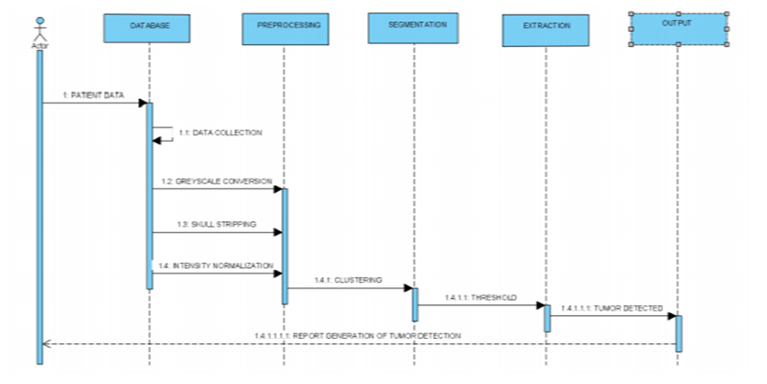
SEQUENCE DIAGRAM

Slide 15
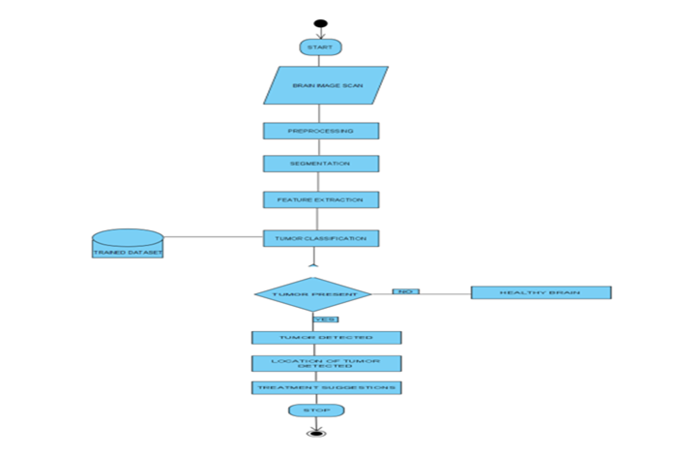
ACTIVITY
DIAGRAM

Slide 16
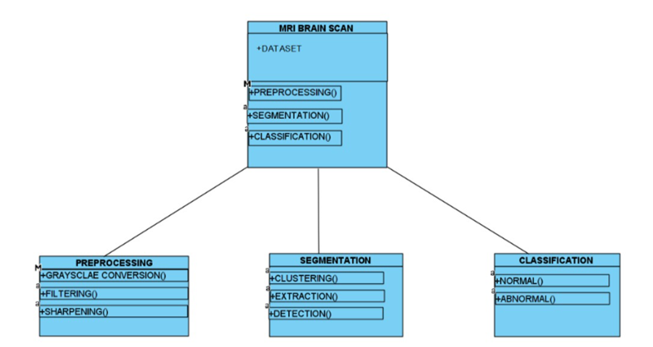
CLASS DIAGRAM

Slide 17
MODULES
Data Pre-Processing
Segmentation
Feature Extraction
Classification
Training and Testing
Treatment Suggestion

Slide 18
MODULE DESCRIPTION

Slide 19
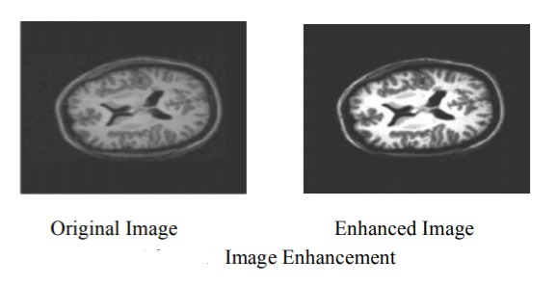
DATA PRE-PROCESSING
Collecting the data is one task and making that data useful is an-other vital task.
Data collected from various means will be in an unorganized format and there may be lot of null values, in-valid data values and unwanted data..
Cleaning all these data and replacing them with appropriate or approximate data and removing null and missing data and replacing them with some fixed alternate values are the basic steps in pre processing of data.
Even data collected may contain completely garbage values. It may not be in exact format or way that is meant to be.
All such cases must be verified and replaced with alternate values to make data meaningful and useful for further processing. Data must be kept in a organized format.

Slide 20
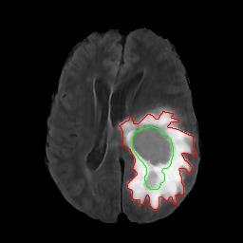
SEGMENTATION
Segmentation technique is to separate out tumor region from MRI image. Using segmentation it is possible to identify objects, boundaries, location in an image.
A lot of research has been carried out in the area of segmentation.
In computer science, it is used for the dividing of digital images into multiple segments.
It is used to achieve the goal to obtain the more meaningful and easier to analyze a image as it simply or change the image representation.
There are many applications of segmentation in medical field like identify the diseases in MRI or CT scan images, to locate tumor.
SEGMENTED IMAGE

Slide 21
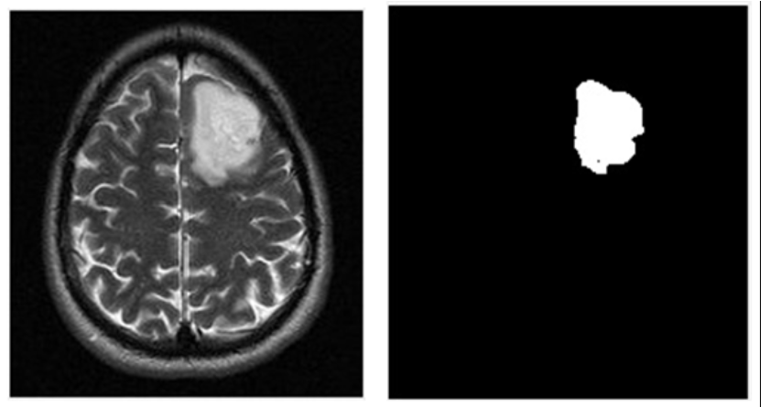
FEATURE EXTRACTION
Feature extraction comes after the segmentation process to point us the exact tumor
Feature extraction is the process of extracting the features of segmented brain tumor.
It is a crucial task in case of brain tumor because of the complex structure of brain.
Certain parameters are taken into account for feature extraction as size, shape, composition, location of image
As per the result obtained from the feature extraction the classification of the tumor is done.
EXTRACTED TUMOR

Slide 22
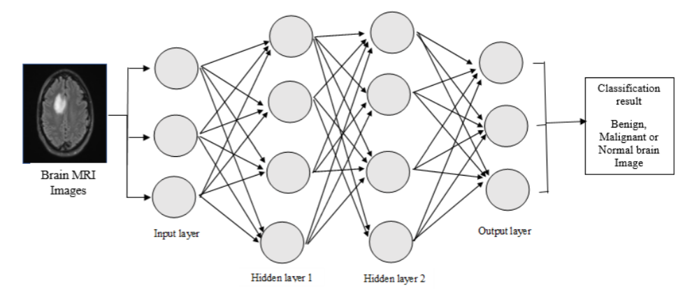
CLASSIFICATION
Image classification is a process of classifying the items according to its type and pattern from the image in the dataset.
Image classification performs on image using CNN algorithm.
This CNN algorithm used to classify it into normal brain or tumor brain.
For example, if we have a MRI brain image and we want to train our CNN on that image to classify it into “normal brain” or “tumor brain”.
CLASSIFICATION USING CNN

Slide 23
TRAINING AND TESTING
Finally after processing of data and training, the very next task is obviously testing. This is where performance of the algorithm, quality of data, and required output all appears out.
From the huge data set collected 90 percent of the data is utilized for training and 10 percent of the data is reserved for testing.
Training as discussed before is the process of making the machine to learn and giving it the capability to make further predictions based on the training it took.
Where as testing means already having a predefined data set with output also previously labeled and the model is tested whether it is working properly or not and is giving the right prediction or not.
If maximum number of predictions are right then model will have a good accuracy percentage and is reliable to continue with otherwise better to change the model.

Slide 24
TREATMENT SUGGESTION
Treatment suggestions includes types of treatment that are the standard of care for a brain tumor.“Standard of Care” means the best treatments known.
Treatment for a brain tumor depends on size, type and location of the tumor cells.
Treatment includes surgery,radiation and chemotherapy.
Surgery
If the tumor located in place that makes accessible for an operation,the surgeon will work to remove the tumor cells as much as possible
Radiation
This therapy uses high energy beams like X-rays or protons to kill tumor cells.It may cause many side effects also.
Chemotherapy
Under this therapy,doctors uses drugs like temozolomide(temodar),which is taken as pill.

Slide 25
REHABILITATION AFTER TREATMENT
There is a need for rehabilitation because brain tumors can develop in parts of the brain that control motor skills,speech,vision and thinking.
Physical therapy to help you regain lost motor skills or muscle strength
Occupational therapy to help you get back to your normal daily activities, including work, after a brain tumor or other illness
Speech therapy with specialists in speech difficulties (speech pathologists) to help if you have difficulty speaking
Tutoring for school-age children to help kids cope with changes in their memory and thinking after a brain tumor

Slide 26
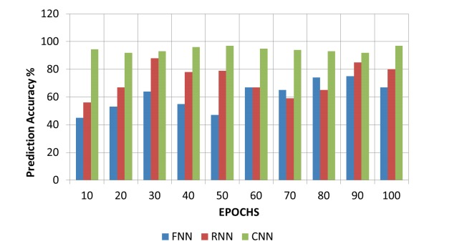
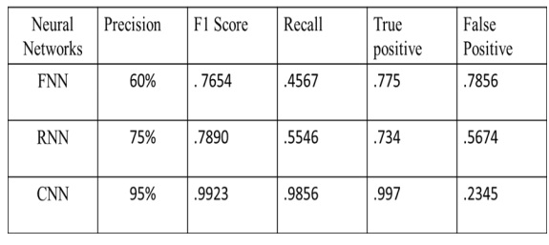
PERFORMANCE EVALUATION
PERFORMANCE GRAPH ON VARIOUS CLASSIFIERS
EVALUATION METRICS ON VARIOUS NEURAL NETWORKS

Slide 27
SCREEN SHOTS

Slide 28
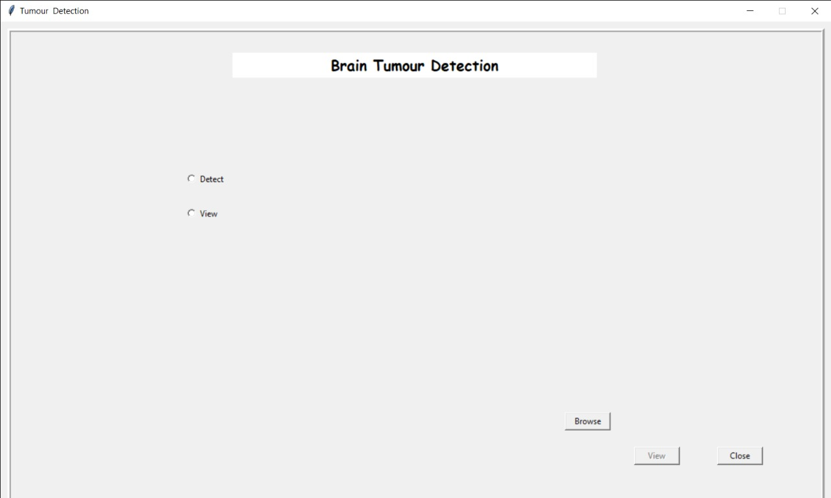

Slide 29
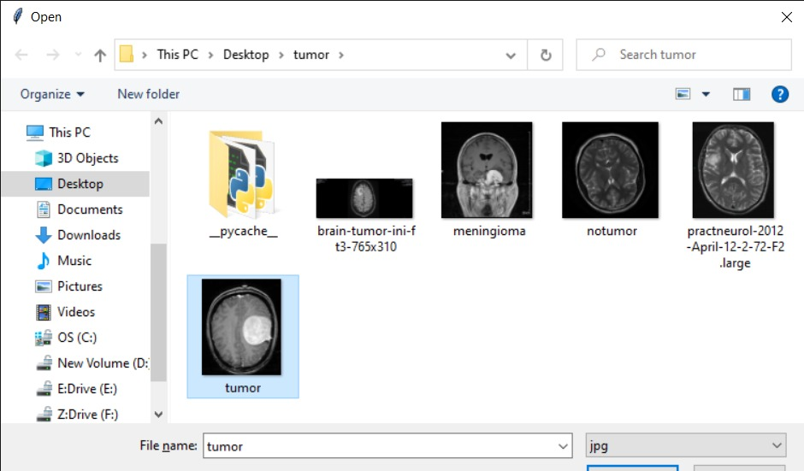

Slide 30
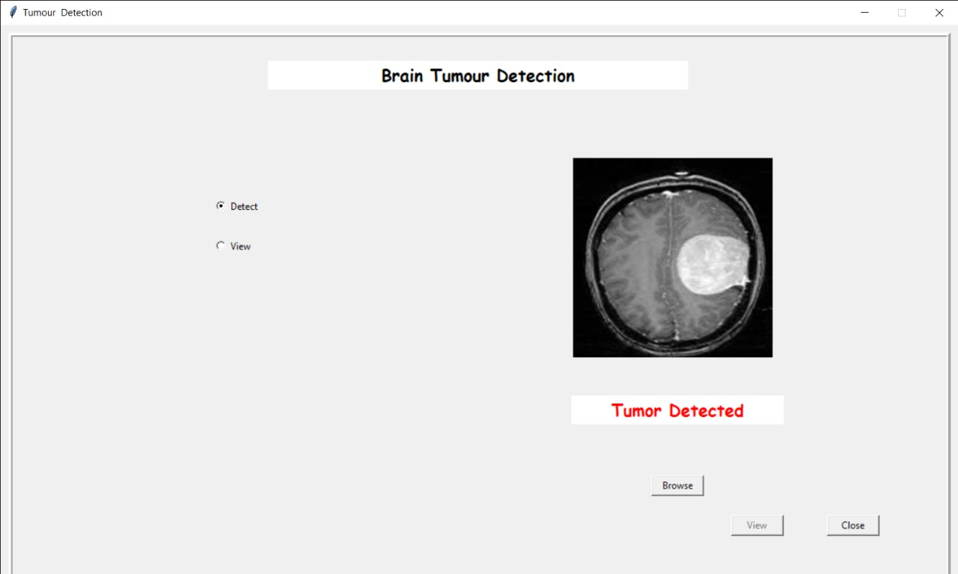

Slide 31


Slide 32
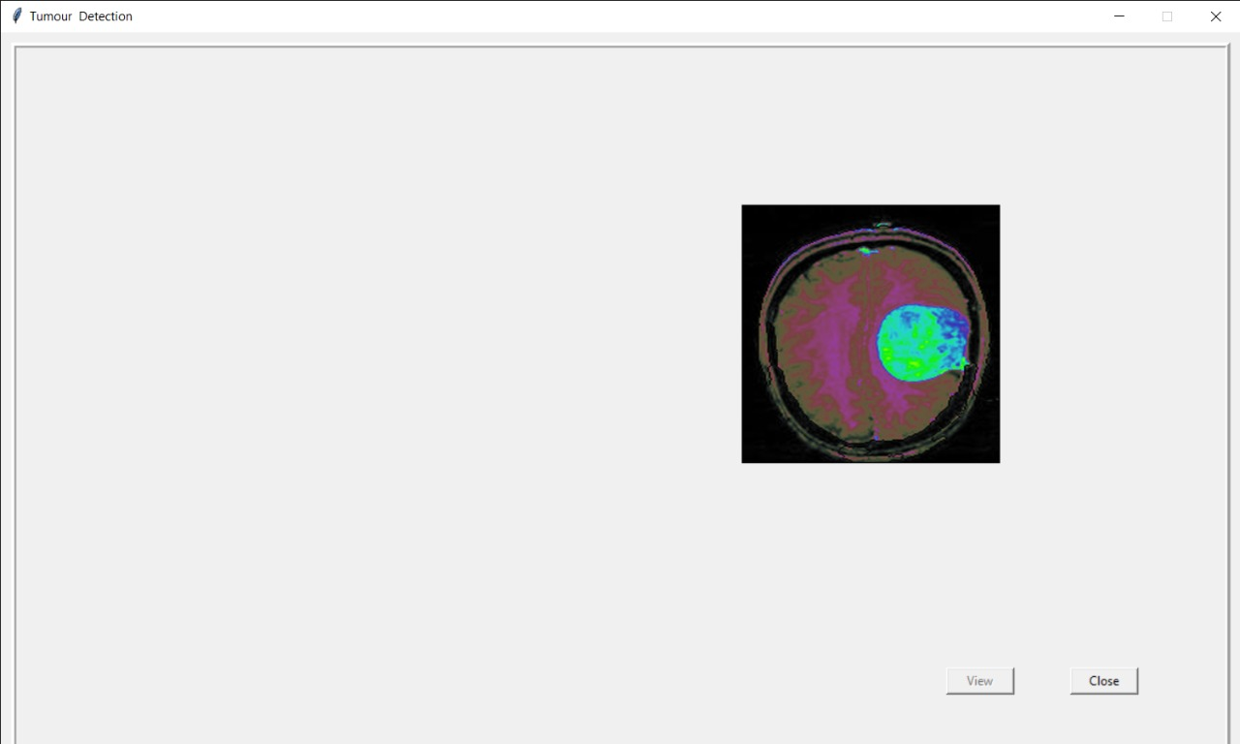

Slide 33
CONCLUSION
In this paper, we have proposed a recommender system of machine learning which is obviously AI. In the recommender system, we used a deep learning algorithm called CNN which is the best algorithm for image recognition since our project is an image based project and also needs to process large amounts of data present in the project. Firstly, we do image processing techniques on input MR image for enhancement of image quality to do further work on it and then to detect and classify MR image into benign and malignant using a proposed CNN algorithm for accurate detection of brain tumor and giving treatment suggestions based on needs. By using this methodology, we improve the efficiency of detection and classification of brain tumors. There is no need for any technical knowledge to work this application since this project is a user interface and it is easily accessible. For physicians, it works like an add on, which reduces their work and time of access.

Slide 34
REFERENCES
[1] C. F. Pasluosta, H. Gassner, J. Winkler, J. Klucken, and B. M. Eskofier, ‘‘An emerging era in the management of Parkinson’s disease: Wearable technologies and the Internet of Things,’’ IEEE J. Biomed. Health Informat., vol. 19, no. 6, pp. 1873– 1881, Nov. 2015, doi: 10.1109/ JBHI.2015.2461555.
[2] De Luca et al., “Now you see me, now you don’t: Protecting smartphone authentication from shoulder surfers,” in Proc. SIGCHI Conf. Human Factors Comput. Syst., Toronto, ON, Canada, May 2014,pp. 2937–2946.
[3] J. Aviv, K. Gibson, E. Mossop, M. Blaze, and J. M. Smith, “Smudge attacks on smartphone touch screens,” in Proc. 4th USENIX Conf.Offensive Technol., Berkeley, CA, USA, 2010, pp. 1–7.
[4] S. Cha, S. Kwag, H. Kim, and J. H. Huh, “Boosting the guessing attack performance on Android lock patterns with smudge attacks,” in Proc. ACM Asia Conf. Comput. Commun. Secur., Abu Dhabi, United Arab Emirates, Apr. 2017, pp. 313–326.
[5] Maiti, M. Jadliwala, J. He, and I. Bilogrevic, “(Smart)watch your taps: Side-channel keystroke inference attacks using smartwatches,” in Proc. ACM Int. Symp. Wearable Comput., Osaka, Japan, Sep. 2015,pp. 27–30.
[6] L. JabaSheela and Dr.V. Shanthi “Image Mining Techniques For Classification And Segmentation Of Brain MRI Data,” Journal of Theoretical and Applied Information Technology,vol.3,Issue.4, Dec. 2007.
[7] P. Vijayalakshmi, K. Selvamani and M. Geetha “Segmentation Of Brain MRI Using K-Means Clustering Algorithm,” International Journal of Engineering Trends and Technology, vol.3, pp. 113- 115, 2011.

Slide 35
THANK YOU : )

